Slide 1
The Law of Contract

Slide 2
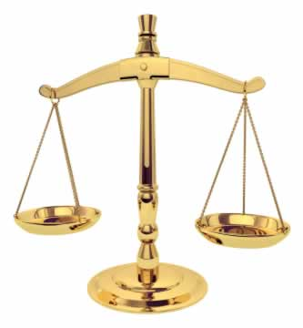
What is a Contract?
A contract is a legally binding agreement between two or more people that is enforceable by law
All contracts have several elements in common

Slide 3

Elements of a Contract
Agreement
Intention
Consideration
Capacity
Consent
Legality of form
Legality of purpose

Slide 4


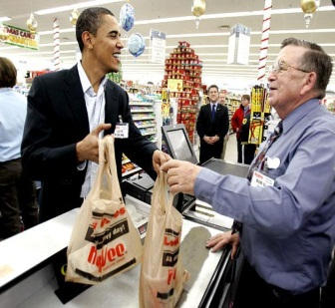
1. Agreement
Agreement occurs when an offer has been accepted
Both must be clear, complete and unconditional
They can be in writing, e.g. purchase of land or property
They can be oral, e.g. at an auction
They can be implied by conduct, e.g. at a checkout

Slide 5
An offer is terminated if there is:
A counter offer
A rejection of the offer
A revocation (the person making the offer backs out)

Slide 6

2. Intention
In order for a contract to take place there must be a willingness and knowledge on both sides that they are entering into a contract
Example: two people arrange to go out for dinner. If one doesn’t turn up, can the other one sue?
Answer: No, there was no intention
to form a contract

Slide 7

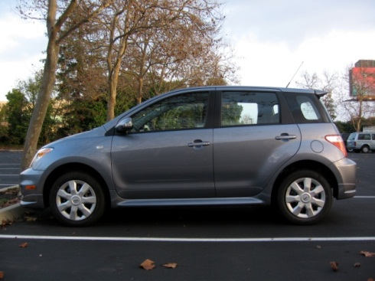


3. Consideration
What one party gives to another
There must be some sort of exchange
It need not reflect the full monetary value of the item, but it must have some measurable value
Example: Shyam buys a car from Ram for Rs 100000 Shyam gets the car and Ram gets the money

Slide 8



4. Capacity
Persons entering into a contract must have the legal ability to do so
Exceptions:
  Under 18
  Persons under the influence of drugs or alcohol
  Bankruptcy
  Company employee who is acting “ultra vires”
  Diplomat can claim diplomatic immunity

Slide 9

5. Consent
The contract must be made voluntarily
It must not be entered into under duress
Both parties must agree to what is in the contract

Slide 10

6. Legality of form
This refers to the manner in which the contract is drawn up, e.g. oral, in writing or implied by conduct
Certain contracts must be in writing, e.g. sale of property, insurance policy

Slide 11

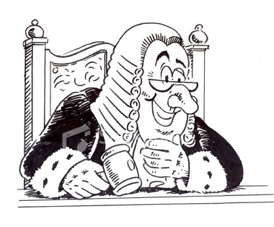
7. Legality of purpose
The contract must not break any laws
Legally binding contracts must be for legal transactions
Agreements to commit a crime will not be upheld in court

Slide 12
10 Essential Elements of a Valid Contract
Offer and Acceptance Every contract starts with a valid offer made by one party and its unqualified acceptance by the other. The terms of the offer should be clear, definite, and communicated to the offeree. Acceptance should mirror the terms of the offer without any modifications.
Example: A house owner offers to sell a house for ₹50 lakh. The buyer agrees to purchase it at the offered price. This is an example of a valid offer and acceptance.

Slide 13
2. Intention to Create Legal Relations
For an agreement to be a contract, the parties need to intend to create legal obligations. Social or domestic agreements usually do not have that intention, whereas business agreements usually do. Although this is not stated in the Indian Contract Act, it is very much accepted.
Example: The agreement between a landlord and tenant to rent a house has legal obligations, whereas the promise to go to a family dinner has no legal obligations.

Slide 14
3. Lawful Consideration It includes the valuation between the parties, including money, goods, services, and a promise. It is real; it must be legal and neither immoral nor prohibited by law.
Example: In consideration of erecting an apartment, a contractor agrees to receive ₹20 lakh in cash. The money paid and the service of construction involved are proper considerations.

Slide 15
4. Capacity of Parties The parties to a contract shall have the legal capacity to do so. That is to say, they must not be minors, they shall be of sound mind and not disqualified by any law.
Example: A 25-year-old with a sound mind making an agreement in partnership is legal. However, an agreement entered with a 16-year-old minor is illegal because they are below legal age

Slide 16
5. Free Consent The contract should be a product of free consent, which is not induced by coercion, undue influence, fraud, misrepresentation, or mistake. In case there is no free consent, the contract is voidable at the option of the aggrieved party.
Example: In case a person is threatened to sell his car, the contract can be declared voidable on the grounds of absence of free consent.

Slide 17
7. Certainty and Clarity The terms of the contract must be clear and not vague or ambiguous. A contract with uncertain terms is void.
Example: An agreement to deliver "a reasonable quantity of rice" is vague and void. But "100 kg of rice at ₹50 per kg" is a valid specification.

Slide 18
Possibility of Performance The contract should have obligations that are capable of being performed. Contracts which require the performance of acts impossible to perform are void.
Example: A contract to deliver goods to a place that has been destroyed by a natural disaster is void for the impossibility of performance.

Slide 19
9. Compliance with Legal Formalities
Some contracts are governed by specific legal formalities. They may be required to be in writing, signed, registered, or attested, depending on their nature. If these formalities are not complied with, then the contract becomes unenforceable.
Example: A sale deed of immovable property is required to be in writing and registered under the law.

Slide 20
10. Agreement Not Expressly Declared Void
A valid contract shall not fall within agreements expressed by the Indian Contract Act as declared to be void; like wagering agreements or those involving unlawful consideration and which restrict trade.
Example: A betting contract has been declared to be void under section 30 as the law expressly declares it unenforceable.

Slide 21
Terminating a Contract
A contract can be terminated or ended in any one of four ways:
Performance
Agreement
Frustration
Breach

Slide 22



1. Performance
Both parties carry out their side of the contract
Example: a builder builds a house and the owner pays the builder

Slide 23

2. Agreement
Both parties agree to end the contract
Example: the homeowner decides not to go ahead with the construction of the new house and the builder agrees to cancel the contract

Slide 24
3. Frustration
Some unforeseen event makes it impossible to carry out the contract
Example: the death of one of the parties to the contract

Slide 25
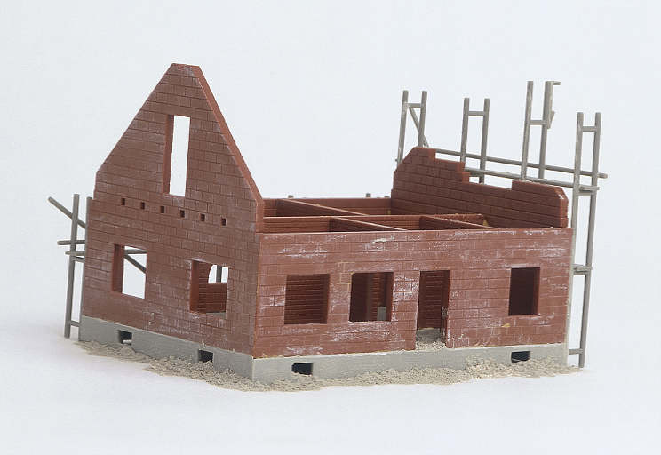
4. Breach
One party to the contract breaks an essential condition of the contract
Example: the builder stops construction before the house is completed

Slide 26
Remedies for Breach of Contract
Rescind the contract
Abandon the contract
Damages
The injured party can sue for compensation
Specific Performance
The courts can order the original contract to be carried out, e.g. the builder may be ordered to complete the construction of the house

